Slide 1
WHAT’S NEW IN ENTITY FRAMEWORK CORE 2.1?
Chris Woodruff

Slide 2




Chris Woodruff
Developer Advocate at JetBrains
.NET, Data, Web
Chris.Woodruff@Jetbrains.com
www.facebook.com/chris.woodruff
www.twitter.com/cwoodruff
www.linkedin.com/in/chriswoodruff

Slide 3
Agenda
Improved LINQ Translation
Owned Entities and Table Splitting
Global Query Filters
DbContext Pooling
String interpolation in raw SQL methods
Explicitly compiled queries
Database scalar function mapping
Parameters in Entity Constructors
Data Seeding
Lazy Loading
LINQ Groupby
Owned Attributes
Raw SQL Parameter Analyzer

Slide 4
Entity Framework Core 2.0 Goals
.NET Standard 2.0
Quality
Performance
Close feature gap with EF 6
Reusable building blocks

Slide 5
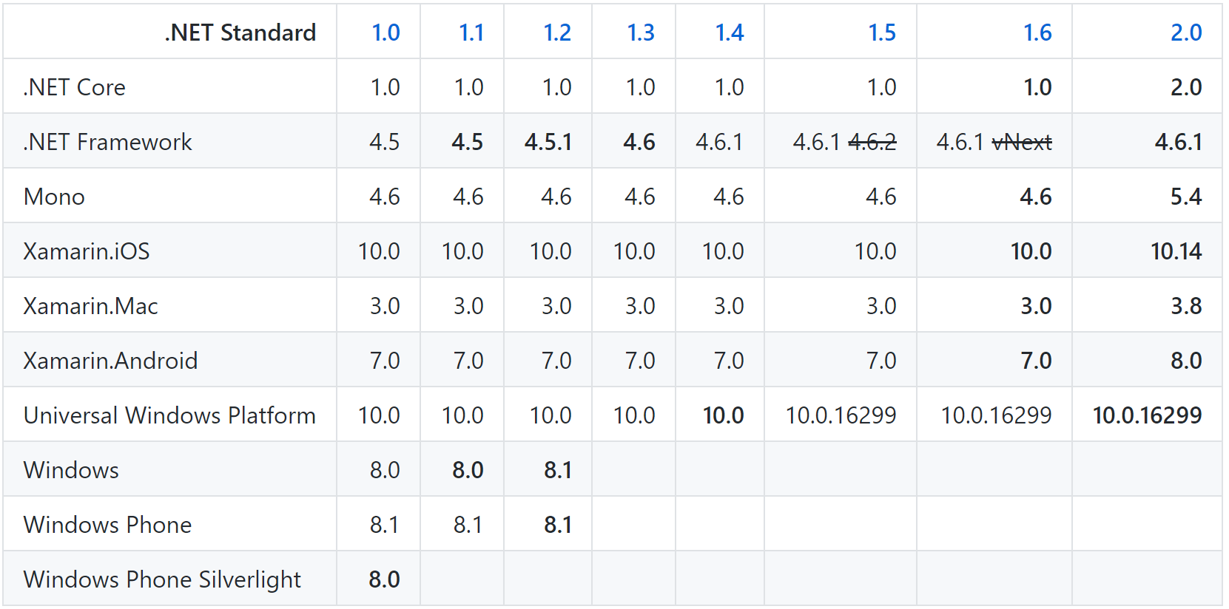
.NET Standard 2.0

Slide 6
Improved LINQ Translation
EF Core 2.0

Slide 7
Like Query Operator
var customers = from c in context.Customers where EF.Functions.Like(c.Name, "a%"); select c;
SELECT .[Id], .[Name] FROM [Customers] AS WHERE .[Name] LIKE N'a%';
EF Core 2.0
Notes:
You can now use EF.Functions.Like() in a LINQ query and it will be translated to LIKE in SQL or evaluated in memory if necessary. E.g. the following query:

Slide 8
Owned Entities and Table Splitting
EF Core 2.0

Slide 9
Owned Entities and Table Splitting
public class Customer
{
public int Id { get; set; }
public string Name {get; set;}
public PhysicalAddress Address { get; set; }
}
public class PhysicalAddress
{
public string StreetAddress { get; set; }
public Location Location { get; set; }
}
...
modelBuilder.Entity<Customer>().OwnsOne(c => c.Address);
EF Core 2.0
Notes:
You can now define “owned” or “child” entities which group properties within other entities, very similar to how complex types used to work in EF6, but with the ability to contain reference navigation properties. In combination with table splitting, owned types allow these two entities to be automatically mapped to a single Customer table:

Slide 10
Global Query Filters
EF Core 2.0

Slide 11
Global Query Filters
modelBuilder.Entity<Post>().HasQueryFilter(p => !p.IsDeleted);
var blog = context.Blogs .Include(b => b.Posts) .FirstOrDefault(b => b.Id == id);
EF Core 2.0
Notes:
You can now specify filters in the model that are applied automatically to all entities of a type in all queries executed on the DbContext. E.g. given this code in OnModelCreating:

Slide 12
DbContext Pooling
EF Core 2.0

Slide 13
DbContext Pooling
DI Container
public class BlogsController : Controller
{
private BlogContext _context;
public BlogsController(BlogContext context)
{
_context = context;
}
public IActionResult Index()
{
return _context.Blogs.ToList();
}
}
Request: /blogs/index
Scope
BlogContext
Blogs
Controller
Request: /blogs/index
Scope
BlogContext
Blogs
Controller
Request: /blogs/index
Scope
BlogContext
Blogs
Controller
Notes:
Many ASP.NET Core applications can now obtain a performance boost by configuring the service registration of their DbContext types to use a pool of pre-created instances, avoiding the cost of creating new instance for every request:

Slide 14
DbContext Pooling
DI Container
public class BlogsController : Controller
{
private BlogContext _context;
public BlogsController(BlogContext context)
{
_context = context;
}
public IActionResult Index()
{
return _context.Blogs.ToList();
}
}
Request: /blogs/index
Context Pool
Scope
BlogContext
BlogContext
Scope
Blogs
Controller
BlogContext
BlogContext
BlogContext
Request: /blogs/index
BlogContext
BlogContext
Blogs
Controller
Scope
Request: /blogs/index
Scope
BlogContext
Blogs
Controller

Slide 15
DbContext Pooling
services.AddDbContext<BloggingContext>( options => options.UseSqlServer(connectionString));
services.AddDbContextPool<BloggingContext>( options => options.UseSqlServer(connectionString));
EF Core 2.0

Slide 16
String interpolation in raw SQL methods
EF Core 2.0

Slide 17
String interpolation in raw SQL methods
var city = "Redmond";
using (var context = CreateContext())
{
context.Customers.FromSql($@“
SELECT *
FROM Customers
WHERE City = {city}");
}
SELECT *
FROM Customers
WHERE City = @p0
SELECT *
FROM Customers
WHERE City = ‘Redmond’
EF Core 2.0

Slide 18
Explicitly Compiled Queries
EF Core 2.0

Slide 19
Explicitly Compiled Queries
static readonly Func<MyEntityContext, int, IEnumerable<MyEntity>>
CompiledQuery =
EF.CompileQuery<MyEntityContext, int, MyEntity>((ctx, id) =>
ctx.MyEntities.Where(x => x.Id == id).Include(x => x.Others).OrderBy(x => x.Name));
var results = CompiledQuery(ctx, 100).ToList();
EF Core 2.0
Notes:
Entity Framework Core included query caching since version 1, but there is still some overhead associated with calculating the key from the query and getting it from the cache. Therefore, version 2 introduced a capability that existed in LINQ to SQL and Entity Framework pre-Core: explicit query compilation and execution. By this, we are able to pre-compile a query and use it in whatever context we want (of a compatible type, of course). We can even eagerly fetch associated collections or entities:

Slide 20
Database scalar function mapping
EF Core 2.0

Slide 21
Database Scalar Function Mapping
public class BloggingContext : DbContext {
[DbFunction]
public static int PostReadCount(int blogId)
{
throw new Exception();
}
}
var query = from p in context.Posts
where BloggingContext.PostReadCount(p.Id) > 5
select p;
EF Core 2.0

Slide 22
Parameters in Entity Constructors

Slide 23
Entity Constructor Parameters
public class Blog { public int BlogId { get; set; } public string Url { get; set; } public List<Post> Posts { get; set; } = new List<Post>(); }

Slide 24
Entity Constructor Parameters
public class Blog { public Blog(int blogId, string url) { BlogId = blogId; Url = url; } public int BlogId { get; set; } public string Url { get; set; } public List<Post> Posts { get; set; } = new List<Post>(); }

Slide 25
Data Seeding

Slide 26
Data Seeding Example
private void DataSeeding(ModelBuilder modelBuilder) { modelBuilder.Entity<Vendor>().HasData( new Vendor { BusinessEntityID = 1, AccountNumber = "838383", Name = "Acme Products", CreditRating = 4, PreferredVendorStatus = false, ActiveFlag = true }); }

Slide 27
Lazy Loading

Slide 28
Lazy Loading Example
Install the Microsoft.EntityFrameworkCore.Proxies NuGet package
Either way to enabling:
protected override void OnConfiguring(DbContextOptionsBuilder optionsBuilder) { optionsBuilder.UseLazyLoadingProxies(). UseSqlServer(myConnectionString); }
services.AddDbContext<ChinookContext>( options => options.UseSqlServer(connection).UseLazyLoadingProxies() );
Notes:
EF Core will then enable lazy loading for any navigation property that can be overridden--that is, it must be virtual and on a class that can be inherited from.

Slide 29
LINQ GroupBy

Slide 30
LINQ GroupBy
var query = context.Orders
.GroupBy(o => new { o.CustomerId, o.EmployeeId })
.Select(g => new
{ g.Key.CustomerId,
g.Key.EmployeeId,
Sum = g.Sum(o => o.Amount),
Min = g.Min(o => o.Amount),
Max = g.Max(o => o.Amount),
Avg = g.Average(o => Amount)
}
);
SELECT [o].[CustomerId], [o].[EmployeeId], SUM([o].[Amount]), MIN([o].[Amount]), MAX([o].[Amount]), AVG([o].[Amount])
FROM [Orders] AS [o]
GROUP BY [o].[CustomerId], [o].[EmployeeId];

Slide 31
Owned Attribute

Slide 32
Owned Attribute Example
[Owned]
public class StreetAddress
{
public string Street { get; set; }
public string City { get; set; }
}
public class Order
{
public int Id { get; set; }
public StreetAddress ShippingAddress { get; set; }
}

Slide 33
Raw SQL Parameter Analyzer

Slide 34
Raw SQL Parameter Analyzer Example
var sql = $"SELECT * FROM People WHERE Age > {minAge}";
var query = context.People.FromSql(sql);
Notes:
the following query, you will see a warning because minAge is not parameterized:

Slide 35
Things to know
EF Core 2.1 won’t be binary compatible with EF Core 1.0
The minimum version of .NET Framework supported is 4.6.1
The minimum version of Xamarin.iOS supported is 10.14
The minimum version of Xamarin.Android supported is 8.0
The minimum version of UWP supported is 10.0.16299
Spatial Data Types high priority but no release plans
Stored Procedures native support not support but work arounds using string interpolation in raw SQL methods

Slide 36
More information?
Docs https://docs.microsoft.com/ef/core
Project https://github.com/aspnet/EntityFrameworkCore
Blog https://blogs.msdn.microsoft.com/dotnet/
Demos https://github.com/anpete/efdemos

Slide 39
Chris Woodruff
Developer Advocate at JetBrains
.NET, Data, Web
Chris.Woodruff@Jetbrains.com
www.facebook.com/chris.woodruff
www.twitter.com/cwoodruff
www.linkedin.com/in/chriswoodruff

